Slide 1
ecbi
european capacity building initiative
initiative européenne de renforcement des capacités
Operationalising the Standing Committee
2012 ecbi Fellowships
Benito Müller
for sustained capacity building in support of international climate change negotiations
pour un renforcement durable des capacités en appui aux négociations internationales sur les changements climatiques
Notes:
CBDR
Responsibility can be measured
There are different types of capability:
Procedural
Institutional
Economic
Aggregation of Responsibility and Capability?

Slide 2
COP Decisions on Standing Committee
Cancun
112. Decides to establish a Standing Committee under the Conference of the Parties to assist the Conference of the Parties in exercising its functions with respect to the Financial Mechanism of the Convention, in terms of improving coherence and coordination in the delivery of climate change financing, rationalization of the Financial Mechanism, mobilization of financial resources and measurement, reporting, and verification of support provided to developing country Parties.
Durban
120. Decides that the Standing Committee shall report and make recommendations to the Conference of the Parties, for its consideration, at each ordinary session of the Conference of the Parties on all aspects of its work;
121. Also decides that the Standing Committee shall assist the Conference of the Parties in exercising its functions with respect to the financial mechanism of the Convention in terms of improving coherence and coordination in the delivery of climate change financing, rationalization of the financial mechanism, mobilization of financial resources, and measurement, reporting and verification of the support provided to developing country Parties through activities, such as the following:

Slide 3
COP Decisions (cont.)
(a) Organizing a forum for the communication and continued exchange of information among bodies and entities dealing with climate change finance in order to promote linkages and coherence;
(b) Maintaining linkages with the Subsidiary Body for Implementation and the thematic bodies of the Convention;
(c) Providing to the Conference of the Parties draft guidance for the operating entities of the financial mechanism of the Convention, with a view to improving the consistency and practicality of such guidance, taking into account the annual reports of the operating entities as well as submissions from Parties;
(d) Making recommendations on how to improve the coherence, effectiveness and efficiency of the operating entities of the financial mechanism;
(e) Providing expert input, including through independent reviews and assessments, into the preparation and conduct of the periodic reviews of the financial mechanism by the Conference of the Parties;
(f) Preparing a biennial assessment, overview of climate finance flows, to include information on the geographical and thematic balance of such flows, drawing on available sources of information, including national communications and biennial reports of both developed and developing country Parties, information provided in the registry, information provided by Parties on assessments of their needs, reports prepared by the operating entities of the financial mechanism, and information available from other entities providing climate change finance;
122. Further decides that the Standing Committee shall perform any other functions that may be assigned to it by the Conference of the Parties;

Slide 4
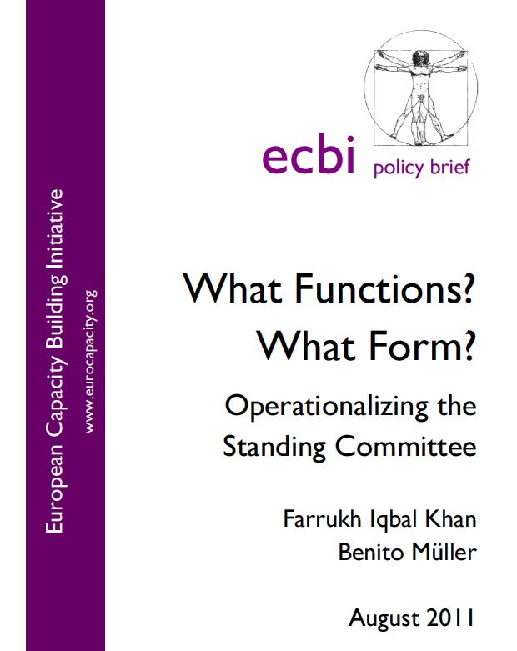
2. Functions
2.1. Guidance, Recommendations and Review
Guidance and recommendations 23
Review 24
2.2. Reporting and verifying of
financial support to developing countries
Reporting 24
Verifying 25
2.3. Other Functions 25

Slide 5
Guidance and recommendations [p.23]
The Standing Committee should support the COP by providing:
annual synthesis reports of the annual reports by the Operating Entities of the Financial Mechanism of the Convention which, for that purpose, should report directly to the Standing Committee;
draft guidance to the Operating Entities; [DPEA 121 c]
draft decisions on how other UNFCCC bodies, such as the Adaptation Committee or the Technology Transfer Executive Committee, are to relate to the Financial Mechanism; [DPEA 121 b (‘maintaining linkages’)]
draft decisions/recommendations on rationalizing the Financial Mechanism; [Cancun]
draft recommendations/guidance to all actors involved in climate finance, with a view to improving coherence in delivery of finance and complementarity in their approaches, including comparable standards, guidelines, and rules of allocation. [Cancun]
draft recommendations/guidance with regard to overcoming thematic and geographical imbalances in the international flows of climate finance. [DPEA 121 f (‘assessment’)]

Slide 6
Review [p.24]
The Standing Committee should support the COP in reviewing:
1. the accountability of the Operating Entities to the COP, inter alia through independent external evaluations; [DPEA, 121.e (‘providing expert input’)]
2. the operational rules and modalities of Operating Entities;
3. the modalities of the Operating Entities with respect to implementation of Art. 11.3 (b) of the Convention*;
4. the modalities for reporting and verifying financial support, including certification by recipient countries (if applicable);
5. resource access modalities, including direct access;
6. (and promoting) comparable standards, guidelines, and rules for the allocation of finance;
7. contractual arrangements between the COP and Operating Entities;
8. the scale of assessed contribution, if applicable;
9. the adequacy of resources, in particular the needs for, and sources and flows of, international financial support.[DPEA, 121.f]
* Modalities by which a particular funding decision may be reconsidered in light of these policies, programme priorities, and eligibility criteria;

Slide 7
Reporting , and Verifying [p. 24 f.]
set up and manage a Financial Support Registry to record all relevant information on financing channels, both inside and outside the Financial Mechanism, particularly with reference to the information required in performing the review functions;
request/invite Operating Entities and other entities involved in providing climate finance to provide required information;
act as a platform of consultation with private sector and civil society, as well as with multilateral and bilateral funding entities; [DPAE, 121.a]
liaise on all relevant matters with other relevant bodies – in particular, but not solely, with Convention bodies such as the Adaptation Committee and Technology Executive Committee;[DPAE, 121.b]
provide the COP with all necessary support to verify:
(i) financial flows to be counted against financial obligations under the Convention, including, if applicable, assessed contributions;
(ii) certification by recipient countries, if applicable.
Other Functions [p. 25]
1. Support the COP in the mobilization of financial resources, including from the private sector, by inter alia:
(a) developing policy frameworks for mobilizing supplementary finance sources for the guidance of, and recommendation to, the Operating Entities;
(b) commissioning independent studies on the topic.
2. Report directly to the COP. [DPEA, 120]
3. Fulfil any other function assigned by the COP.

Slide 8
The Nature of the Beast?
Expert Group or Subsidiary Body?
Workplan
Draft Guidance to OEs
COP-GCF Agreement
Review of FM, SBI Mandate

