Slide 1
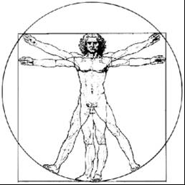
ecbi
european capacity building initiative
initiative européenne de renforcement des capacités
Equity and CBDR/RC on the Durban Platform
2012 ecbi Fellowships
Benito Müller
for sustained capacity building in support of international climate change negotiations
pour un renforcement durable des capacités en appui aux négociations internationales sur les changements climatiques
Notes:
CBDR
Responsibility can be measured
There are different types of capability:
Procedural
Institutional
Economic
Aggregation of Responsibility and Capability?

Slide 2
UNFCCC Article 3.1
[Art. 3.1] The Parties should protect the climate system for the benefit of present and future generations of humankind, on the basis of equity and in accordance with their common but differentiated responsibilities and respective capabilities. Accordingly, the developed country Parties should take the lead in combating climate change and the adverse effects thereof.
What is done to protect the climate system, and how it is carried out should be equitable and in accordance with CBDR/RC.
How? Procedural Justice
What? Distributive Justice
➔ Distributive Justice
Notes:
This is not about a duty to do good (charity) – Broom – but about justice, which means duties/rights

Slide 3
Distributive Justice: Definitions
Distributive Justice: the justice that is concerned with the apportionment of privileges, duties, and goods in consonance with the merits of the individual and in the best interest of society
Distributive Justice
Principles of distributive justice are normative principles designed to guide the allocation of the benefits and burdens of economic activity.
http://plato.stanford.edu/entries/justice-distributive/
As far as distributive justice definition is concerned, the term distributive justice is referred to as equal distribution of resources that are scarce among all demographics and population sectors, no matter what socioeconomic group they belong.
http://www.justicedefinition.com/distributive-justice-definition.html

Slide 4
Two Paradigms
− one Methodology
‘This, then, is what the just is – the proportional; the unjust is what violates the proportion.’
Aristotle, Nicomachean Ethics, Book V
I. “Resource Allocation”:
Sharing limited emission permits/space between countries
Proposed Distributive Justice Principle: Egalitarian (‘per capita’)
Aristotelian parameter: population size
II. “Burden sharing”:
Sharing costs/benefits of the manner in which the climate system is being protected.
Proposed Distributive Justice Principles: Polluter Pays (and Solidarity)
Aristotelian parameters: responsibility levels (and capability levels)
NB:
Allocations of emissions permits/space will impose (direct) costs and benefits, and they will have to be treated as just, if the allocations are deemed to be just.
Burden sharing covers more issues than mitigation (e.g. adaptation and impact burdens) that will have to be addressed.

Slide 5
What differentiation?
United States Input to the Negotiating Text for Consideration at the 6th Session of the AWG-LCA
(4 May 2009)
Section 1 – Mitigation : Article 2
1. Developed country Parties:
a. For each such Party, Appendix 1 includes quantitative emissions reductions/removals in the 2020/[ ] timeframe, in conformity with domestic law.
b. Each such Party shall formulate and submit a low-carbon strategy for long-term net emissions reductions of at least [ ] by 2050.
2. Recognizing that the circumstances of countries naturally evolve over time, Paragraph 1 above shall apply, when Appendix 1 is next updated, to other Parties in accordance with objective criteria of economic development.
3. Developing country Parties whose national circumstances reflect greater responsibility or capability:
a. For each such Party, Appendix 1 includes nationally appropriate mitigation actions in the 2020/[] timeframe that are quantified (e.g., reduction from business-as-usual) and are consistent with the levels of ambition needed to contribute to meeting the objective of the Convention.
b. Each such Party shall formulate and submit a low-carbon strategy for long-term net emissions reductions by 2050, consistent with the levels of ambition needed to contribute to meeting the objective of the Convention.
c. Appendix 1 shall include date(s) by which the Party will commit to the type of action referred to in paragraph 1(a) above.
d. Other developing country Parties should implement nationally appropriate mitigation actions and develop low-carbon strategies, consistent with their capacity.

Slide 6
What responsibility?
The state or fact of being accountable; liability, accountability for something
The fact of having a duty to do something.

Slide 7
Responsibility to
“With Great Power Comes Great Responsibility”
‘Today we have learned in the agony of war that great power involves great responsibility.’
Franklin D. Roosevelt, 1945 Jefferson Day Dinner speech
(Posthumously published in Ben D. Zevin, Nothing to Fear: The Selected Addresses of Franklin D. Roosevelt, 1932-1945:p.455)
‘Un grand pouvoir implique de grandes responsabilités’
Attributed to Voltaire
(Œuvres de Voltaire, Volume 48, Lefèvre, 1832,
not verified)

Slide 8
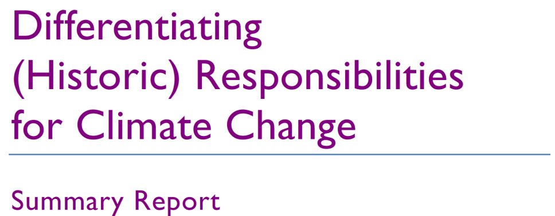
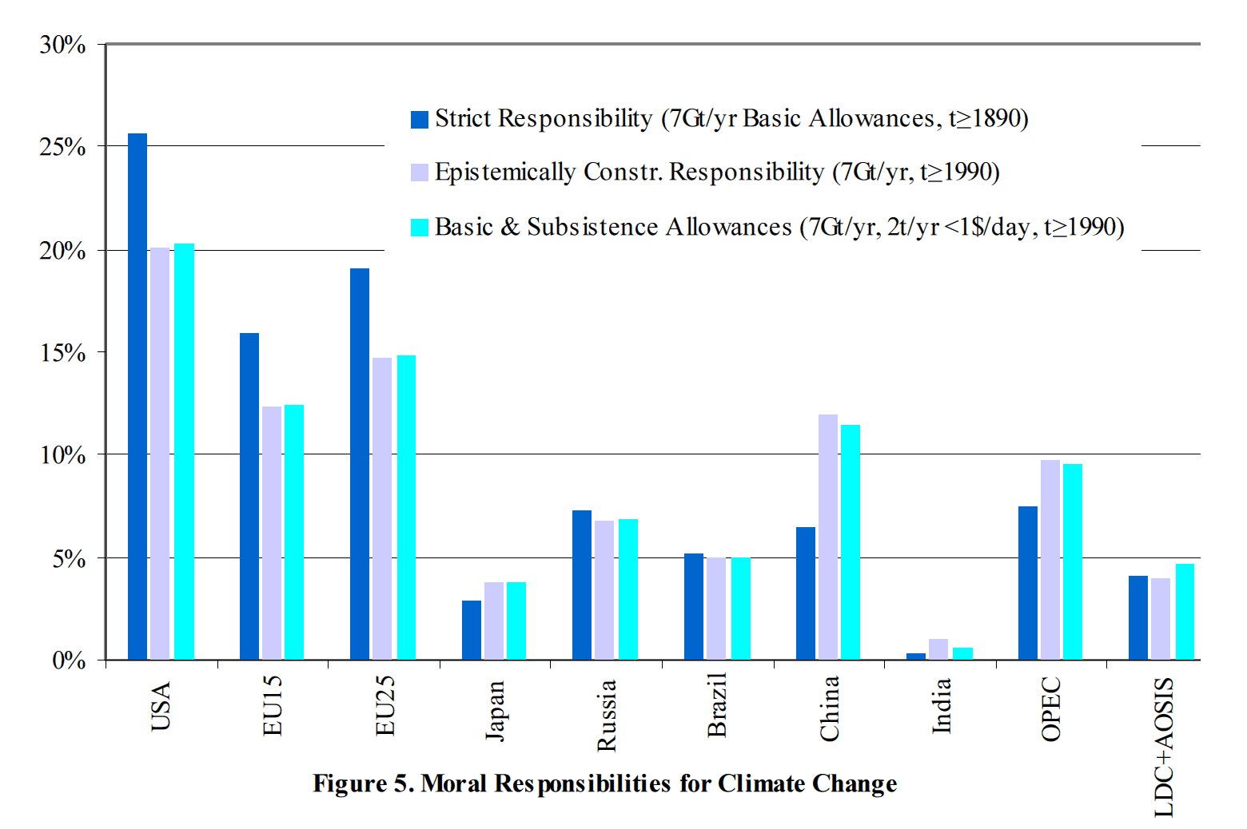
Responsibility for
Benito Müller, Niklas Höhne,
and Christian Ellermann (October 2007)

Slide 9
What equity?
b : the money value of a property or of an interest in a property in excess of claims or liens against it.
I. In general.
The quality of being equal or fair; fairness, impartiality; even-handed dealing.
II. In Jurisprudence.
The recourse to general principles of justice (the naturalis æquitas of Roman jurists) to correct or supplement the provisions of the law. equity of a statute: the construction of a statute according to its reason and spirit, so as to make it apply to cases for which it does not expressly provide.
Notes:
The Latin æquitas was somewhat influenced in meaning by being adopted as the ordinary rendering of Greek ἐπιείκεια [epieikeia], which meant reasonableness and moderation in the exercise of one's rights, and the disposition to avoid insisting on them too rigorously. An approach to this sense is found in many of the earlier English examples.

Slide 10
Equality on the Durban Platform
Aristotle’s principle of formal equality:
“Treat like cases as like”
Nicomachean Ethics, V.3. 1131a10-b15;
Politics, III.9.1280 a8-15, III. 12. 1282b18-23
Full Aristotelian Conception
Descriptively equal cases ought to be treated equally, descriptively unequal cases ought to be treated unequally, according to their degree of inequality.

Slide 11
ecbi
european capacity building initiative
initiative européenne de renforcement des capacités
The Oxford Measure −
of Capability to Pay
2012 ecbi Fellowships
Benito Müller
for sustained capacity building in support of international climate change negotiations
pour un renforcement durable des capacités en appui aux négociations internationales sur les changements climatiques
Notes:
CBDR
Responsibility can be measured
There are different types of capability:
Procedural
Institutional
Economic
Aggregation of Responsibility and Capability?

Slide 12
Capability as Ability to Pay − A Taxation Model
Capability = Gross Capability minus Capability Adjustment
C_{k} = GC_{k} − Ca_{k} [cu : capacity unit]
taxable income = gross income minus tax allowances
Tax Liability vs Charity
Gross Capability Axioms (gdp = GDP/cap)
If gdp_{k} = gdp_{m} then GC_{k} : GC_{m} = GDP_{k} : GDP_{m}
If GDP_{k} = GDP_{m} then GC_{k} : GC_{m} = GDP_{k} : GDP_{m}

Slide 13
Capability as Ability to Pay − A Taxation Model
Homogeneous World Solution (gdp_{k} ≡ gdp_{m} )
Gross Capability = National Income
GC_{k} ≈ GDP_{k}
Oxford Gross Capability
Gross Capability = Progressively weighted National Income:
OGC_{k} = γ_{k} × GDP_{k}, with γ_{k} = gdp_{k} / gdp_{world} [cu/$]

Slide 14
Gross Capability Examples
World per capita GDP (2009): $10’643

Slide 15
Gross Capability Examples
OGC_{k} = γ_{k} × GDP_{k}, [γ_{k} = gdp_{k} / gdp_{world} ]
World per capita GDP (2009): $10’643

Slide 16
Gross Capability Examples
OGC_{k} = (γ_{k})^{δ} × GDP_{k}, δ ≥ 0

Slide 17
Gross Capability Examples
OGC_{k} = (γ_{k})^{δ} × GDP_{k}, δ ≥ 0
Reference level

Slide 18
Oxford Measure − Capability Adjustment
Capability = Gross Capability minus Capability Adjustment
Adjustment for what?
The size of the domestic poverty problem
Poverty Capability Adjustment PCA_{k}
Measuring the size of the poverty problem − two dimensions:
Poverty Headcount PH_{k} [number of poor people]
Poverty Intensity Index: PI_{k} [scalar]
Global Poverty Capability Allowance Π [cu/person]
Differentiated Poverty Capability Allowance Π_{k} = Π × PI_{k} [cu/person]
PCA_{k} = Π_{k} × PH_{k} [cu]
Multidimensional Poverty Index: MPI_{k} [scalar]
PCA_{k} = Π × P_{k} × MPI_{k} , with P_{k} = population

Slide 19
Oxford Measure − Global Capability Allowance Π
Poverty Capability Adjustment =
Global Capability Poverty Allowance (Π) ×
Population × Multidimensional Poverty Index
PCA_{k} = Π × P_{k} × MPI_{k} ,
Zero Capability Allowances (ZCA_{k})
OCM_{k} = OGC_{k} − Π × P_{k} × MPI_{k}
0 = OGC_{k} − ZCA_{k} × P_{k} × MPI_{k}
Π =_{def} 3 × ZCA_{LDC}
Zero Capability Allowances
Africa(-) = Sub-Saharan w/o South Africa

Slide 20
Gross and Net Capability Examples
Reference level

Slide 21
Net Capability:
Sensitivity to Choice of Poverty Allowance Π
Poverty Allowance Π = ZCA_{LDC} ×
Capability Intensity (OCM_{k} /GDP_{k})
LDC
Slope = ̶ Poverty Intensity
−(Poverty Headcount × Poverty Intensity)/GDP
−(PH_{k} × PI_{k} )/ × GDP_{k}

Slide 22
Oxford Measure: Capability Headroom
Capability Headroom = − Capability/GDP [%]
(for countries with negative capability)
Burundi 666%
δ = 1, Π = 3 × ZCA_{LDC}

Slide 23
Oxford Measure − Sample Capabilities I
δ = 1, Π = 3 × ZCA_{LDC}
Non-zero Capability
Zero Capability

Slide 24
Oxford Measure − Sample Capabilities II
δ = 1, Π = 3 × ZCA_{LDC}
Non-zero Capability
Zero Capability

Slide 25
Thank you!

