Slide 1
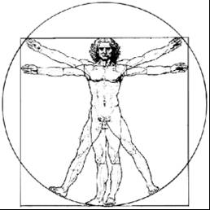
ecbi
european capacity building initiative
initiative européenne de renforcement des capacités
Acronyms used in multilateral negotiations
Brianna Craft
IIED
for sustained capacity building in support of international climate change negotiations
pour un renforcement durable des capacités en appui aux négociations internationales sur les changements climatiques

Slide 2
CMP
Conference of the Parties serving as the meeting of the Parties to the Kyoto Protocol

Slide 3
SBSTA
Subsidiary Body for Scientific and Technological Advice

Slide 4
APA
The Ad Hoc Working Group on the Paris Agreement

Slide 5
MRV
Measurement, Reporting and Verification

Slide 6
BUR
Biennial Update Reports

Slide 7
PCCB
Paris Committee on Capacity-building

Slide 8
TEM
Technical Expert Meeting

Slide 9
CBDRRC
Common but Differentiated Responsibilities and Respective Capabilities

Slide 10
CMA
Conference of the Parties serving as the meeting of the Parties to the Paris Agreement

