Slide 1
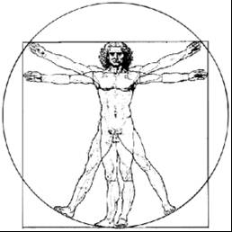
ecbi
Effectively Delivering
on Gender in the UNFCCC
Gender Action Plan and the Paris Work Programme
Geert Fremout
Federal Public Service Public Health, Food Chain Safety & Environment
european capacity building initiative
initiative européenne de renforcement des capacités
for sustained capacity building in support of international climate change negotiations
pour un renforcement durable des capacités en appui aux négociations internationales sur les changements climatiques

Slide 2
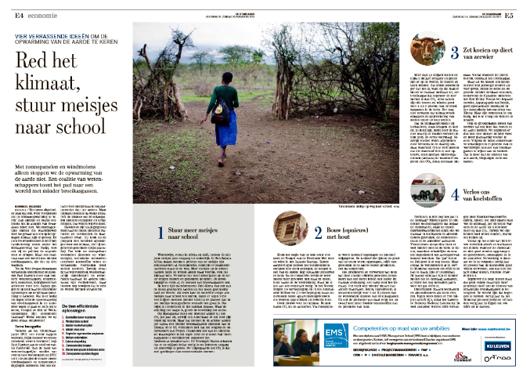
De Standaard, 19-20 August 2017
Source : www.standaard.be

Slide 3
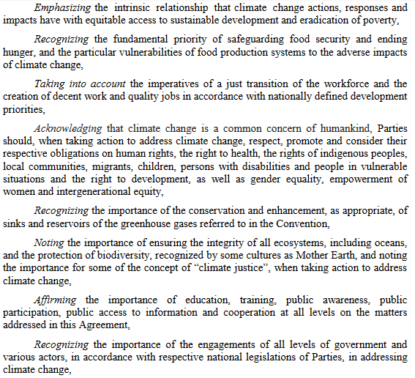
The broader context : the Paris Agreement and the SDGs

Slide 4
The broader context : the Paris Agreement and the SDGs
Source : www.wri.org

Slide 5
Gender under UNFCCC : Milestones
Steady progress
Gender decisions 36/CP.7, 23/CP.18, 18/CP.20 (Lima Work Programme on Gender) and 21/CP.22 (extending Lima Work Programme)
Impressive list of gender mandates in integrated in UNFCCC decisions
Standalone COP agenda item since 2012
Gender focal point in UNFCCC Secretariat
However, implementation remains a challenge → 21/CP.21 : Gender Action Plan

Slide 6
Gender under UNFCCC : The Gender Action Plan (GAP
21.CP/22 : Requests the Subsidiary Body for Implementation to develop a gender action plan in order to support the implementation of gender-related decisions and mandates under the UNFCCC process, which may include priority areas, key activities and indicators, timelines for implementation, the responsible and key actors and indicative resource requirements for each activity, and further elaborate its process of review and monitoring;
March 2017 : informal consultation The Hague
May 2017 : in-session workhop Bonn
September 2017 : Informal consultation Ottawa

Slide 7
Gender under UNFCCC : GAP clusters
Capacity building, knowledge sharing and communication
Gender Balance, participation and women’s leadership
Coherence within the UNFCC and other agencies
Gender-responsive implementation and Means of Implementation
Monitoring and reporting

Slide 8
Gender in the Paris Agreement
Preamble P 11 : Acknowledging that […] Parties should, when taking action to address climate change, respect, promote […] gender equality, empowerment of women […],
Art. 7.5 : Parties acknowledge that adaptation action should follow a […], gender-responsive, […] approach […]
Art. 11.2 : […] Capacity-building [….] be an effective, iterative process that is participatory, cross-cutting and gender-responsive.

Slide 9
Gender in the NDCs
59 Parties refered to gender in their INDC.
Explicitly recognize the role of women as agents of change in the transformation towards a low-carbon and resilient society (Mexico)
Include gender perspective as a cross-cutting issue in national development models, recognizing that climate change will disproportionately impact particularly vulnerable groups (Peru)
Recognize the need to develop gender-neutral policies and measures that bring social inclusion, improve livelihood security, increase resilience, and reduce emissions (Nigeria)
(source : WRI)

Slide 10
Gender under the Paris Work Programme
[NDCs and Adaptation Communications] : Encourage Parties to integrate gender considerations (etc…) in their Nationally Determined Contributions and Adaptation Communications
[Transparency Framework :] Encourage Parties, when reporting on their climate policies […], to include information on how they are integrating gender considerations (etc..) into such policies (also 21/CP.21)
[Global Stocktake :] Include an aggregate assessment of integration of the gender (etc… ) dimension in the GST

Slide 11
Questions for discussion
How ensure that climate action is not promoted in isolation, but integrated with other aspects of sustainable development (including gender)?
How to enhance effective implementation of the gender mandates under the UNFCCC?
What can/should be done under the Paris Work Programme to make this happen?

Slide 12
Thank you for your attention!
geert.fremout@environment.belgium.be

Slide 13
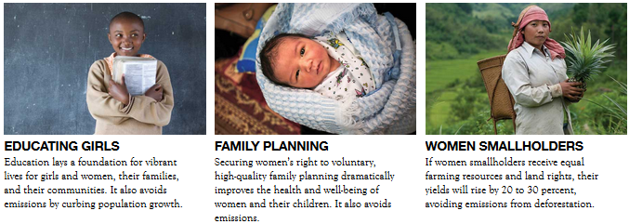
Back up Slide - Project Drawdown
http://www.drawdown.org/solutions

