Slide 1
ecbi
Adaptation Communications
Why, what and how?
Sven Harmeling, with inputs from
Alejandra López Carbajal and Irene Suárez
european capacity building initiative
initiative européenne de renforcement des capacités
for sustained capacity building in support of international climate change negotiations
pour un renforcement durable des capacités en appui aux négociations internationales sur les changements climatiques

Slide 2
Contents
What? The Adaptation Communication in the Paris Agreement
How?
Linkages of the Adaptation Communications and other provisions of the Paris Agreement
Implementation timeline
Key issues around the Adaptation Communications
Fundamental questions to be addressed by COP23

Slide 3
I. What? The Adaptation Communication in the Paris Agreement
Art. 7.10: “Each Party should, as appropriate, submit and update periodically an adaptation communication, which may include its priorities, implementation and support needs, plans and actions, without creating any additional burden for developing country Parties.”
Overarching content: priorities, implementation and support needs, plans and actions
Boundaries: no additional burden for developing countries
Notes:
Why?
-The novelty of the adaptation communication will be provided by its guidance.
-The key aspect of clarity of what is required for the present and future to ENHANCE ACTION.
-Ensure that the new regime for adaptation does not create new burdens where we duplicate what we are doing in other processes i.e. reporting processes.
IPCC AR5. Even if high levels of mitigation = impacts of climate change will demand adaptation measures and represent unavoidable loss and damages.
Developing countries are already making significant investments in adaptation, which often compliment but can also divert resources away from other development priorities
Adaptation Gap (UNEP 2016): costs of adaptation in developing countries could range between USD 140 billion to 300 billion by 2030 and between USD 280 billion and USD 500 billion by 2050 – depending on levels of mitigation ambition.
GGA - need for:
Enhancing adaptive capacity
Strenghtening resilience
Reducing vulnerability to CC
In the context of the temperature goal set out in Article 2. Well below 2 degrees.
The Paris Agreement: new dimension for adaptation (GGA, strenghthen cooperation and action, part of the GST)

Slide 4
I. What? Adaptation Communication in the Paris Agreement
Art. 7.11: “The adaptation communication referred to in paragraph 10 of this Article shall be, as appropriate, submitted and updated periodically, as a component of or in conjunction with other communications or documents, including a national adaptation plan, a nationally determined contribution as referred to in Article 4, paragraph 2, and/or a national communication.”
timing: “shall periodically” but intervals are left open.
vehicles: submission in conjunction with other vehicles, e.g. NAPs, NDC, NC, but no clear provision = choice of vehicles
The amount of flexibility increases importance of guidance and the balance between degrees of flexibility, effectiveness and guidance.
Notes:
Flexibility in choice of vehicles reduces the risk of overburdening developing countries

Slide 5
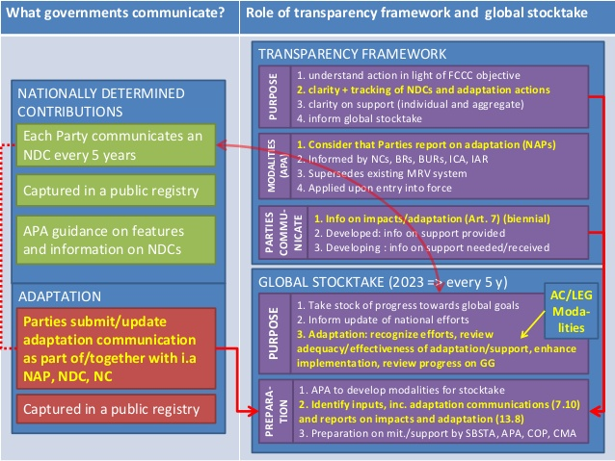
II. a. How? Linkages of the Adaptation Communication and other provisions of the Paris Agreement
Global Goal on Adaptation
Adaptation Communication Vehicles
NDCs
Nat. Comms
NAPs
Biennial reports?
https://www.slideshare.net/OECD_ENV/adaptation-and-transparency-in-the-paris-agreement-by-olga-pilifosova
Notes:
It is essential to first understand the linkages i.e. role of adaptation communication in GST; the reporting of the adaptation communication in ETF etc. BEFORE and in parallel locking in the guidance of the adaptation communication.
Registry. Given the flexibility of vehicles, use of registry would be centralized and somehow standardized.
ETF.
Role of the NatCom
Role of biennial reporting for adaptation. As appropriate and in relation to a-NDC.
Current headings: need to keep them simple, broad and general.
GST.
Clear mandates: 7.14 a, b, c and d.
For adaptation communications: USE FOR ENHANCED IMPLEMENTATION AND WORK TOWARDS ASSESSING GGA.

Slide 6
II. b. How? Implementation timeline
2017 2018 2019 2020 2021 2022 2023 2024 2025 2026 2027 2028 2029 2030 2031 2032 2033
NatComms
Biennial Reports
NDCs
NAPs
Notes:
NDCs >>forward-looking, higher level: The most important role of the NDCs is to outline forward-looking objectives and targets for action, as nationally determined, including on adaptation
NAPs >> forward-looking, detailed planning: In CAN’s view, National Adaptation Plans (NAPs) are primarily a national planning tool which can provide a roadmap towards achieving objectives outlined in the NDCs or various types of national development plans. Submitting them to UNFCCC is useful for information purposes.
National Communications >> backward-looking reporting: prepared every 4 years, focus on providing information on actions and policies already undertaken;
What role for Biennial reports to be presented under the enhanced transparency framework (similar to NC)? Article 13 paragraph 8 requires that each party provides information related to climate change impacts and adaptation, as appropriate

Slide 7
II. c. How? Key issues of the Adaptation Communications
Purpose/s:
- Raise/enhance the profile of adaptation
- Contribute and inform progress towards the GGA
- Catalysing adaptation action
- Enhancing support for adaptation actions and plans
- Communicating adaptation actions
- Recognition of adaptation efforts
- Facilitating learning by sharing best practices and lessons learned
- Informing future decisions under the UNFCCC
Guidance and flexibility:
Common purpose for all Parties / additional purpose/s
Opt in – opt out
Notes:
Guidance and flexibility:
Common purpose for all Parties / additional purpose/s
Opt in – opt out

Slide 8
II. c. How? Key issues of the Adaptation Communications
Elements:
- National circumstances
- Impacts, vulnerabilities and risk assessments
- Priorities, plans, strategies, programmes, policies and actions
- Adaptation support needs / implementation and support needs
- Adaptation efforts
- Monitoring and evaluation of adaptation actions
- Biennial communication of indicative support from developed countries in terms of finance, technology and capacity building
Common / additional purpose/s
Opt in – opt out
Notes:
7.10 Basis for core elements

Slide 9
III. Fundamental issues to consider at COP23
What is the added value of the Adaptation Communication? How to ensure this added value persists independently of the vehicle to be used?
Consideration of interlinkages while defining guidance for the Adaptation Communication
Notes:
Outlook COP23: Pre-sessional roundtable on 4 Nov and agreeing on negotiation basis for 2018 towards CMA1 decision at COP24
Flexibilities raised:
choice of vehicle;
frequency of communication and updating
decision to not submit a communication should not involve ramifications
challenge of ensuring balance between flexibility and the need for consistency

Slide 10
Thank you
Notes:
Outlook COP23: Pre-sessional roundtable on 4 Nov and agreeing on negotiation basis for 2018 towards CMA1 decision at COP24
Flexibilities raised:
choice of vehicle;
frequency of communication and updating
decision to not submit a communication should not involve ramifications
challenge of ensuring balance between flexibility and the need for consistency

Slide 11
Existing guidance: commonalities
NDC A-components often included:
National circumstances informing the adaptation component;
Long-term goals and/or visions guiding the adaptation component;
Impact and vulnerability assessments;
Legal and regulatory frameworks, strategies, programmes and plans that provide the basis for, or have informed, adaptation actions;
Measures or actions planned or under implementation in specific areas and/or sectors;
Costs, losses and/or damage due to climate impacts;
Means of implementation;
M&E of adaptation;
Synergies between mitigation & adapt
NatComms:
- scope of their vulnerability
and adaptation assessment
- description of approaches, methodologies and tools used
Information in direct and indirect impacts of CC
provide information on and, to the extent possible, an evaluation of, strategies and measures for adapting to climate change
may report on the use of policy frameworks,
Dec. 17/CP.8
Notes:
LnD covered under Art.8 not Art.7 nor by Adaptation Communication.

